Slide 1
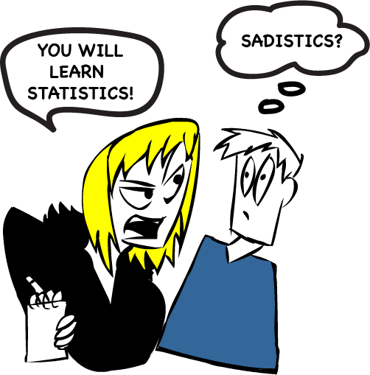
Confidence Intervals
Proportions
Dr. Abolfazl Saghafi
Assistant Professor of Statistics & Data Science
Data Science Program Director

Slide 2
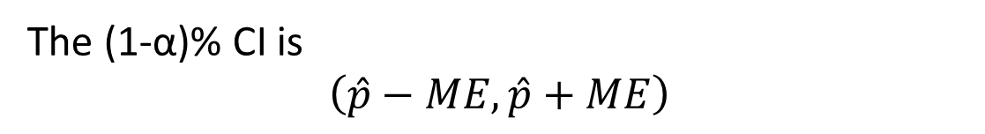

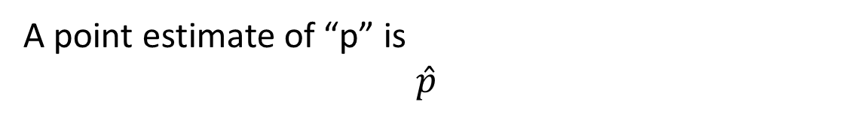
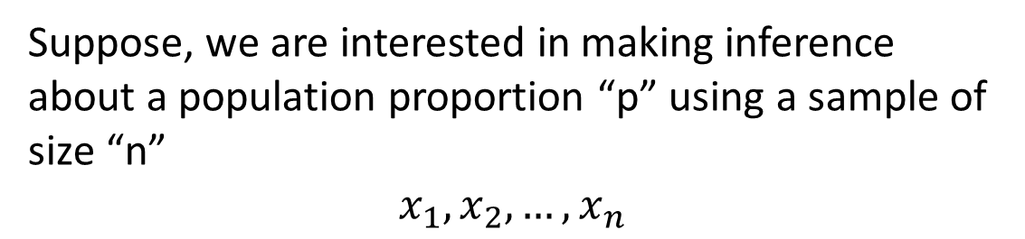

Population Proportion
For example, parameter “p” could be the proportion of females in a population computed by
or the percentage of people who vote for a specific candidate; or the proportion of people who suffer from a disease; or the proportion of damaged products, etc.
Suppose, we are interested in making inference about a population proportion “p” using a sample of size “n”
$$x_{1},x_{2},…,x_{n}$$
A point estimate of “p” is
$$\hat{p}$$
A point estimation for “p” is the same proportion computed in a sample, for example
The Margin of Error is
$$ME=z_{1−α/2}\sqrt{\frac{\hat{p}\left(1−\hat{p}\right)}{n}}$$
The (1-α)% CI is
$$\left(\hat{p}−ME,\hat{p}+ME\right)$$
Read $\hat{p}$as p-hat

Slide 3
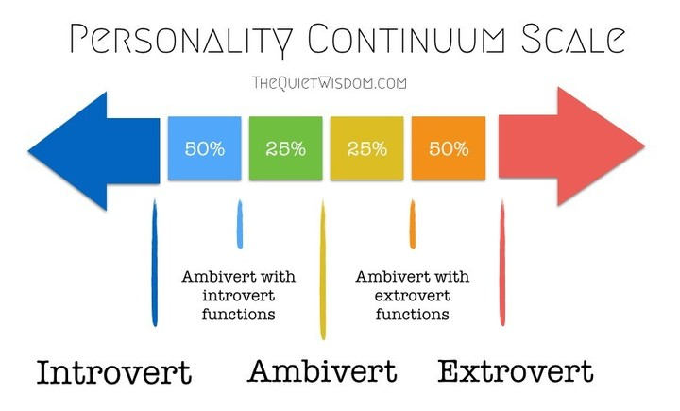
Example
A researcher applied Isabel Myer’s method on professional actors to determine what percent were extroverts. In a random sample of 62 professional actors, it was found that 39 were extroverts.
a) Let p represent the proportion of all actors who are extroverts. Find a point estimate for p.
b) Find a 95% CI for p. Interpret the result.

Slide 4


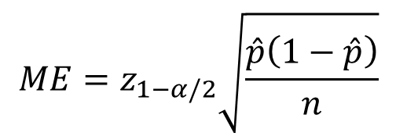



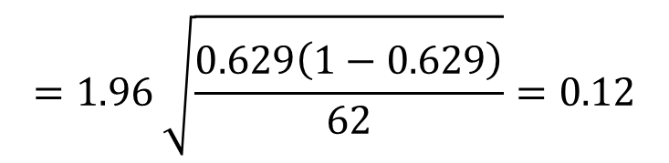

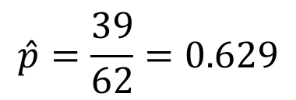

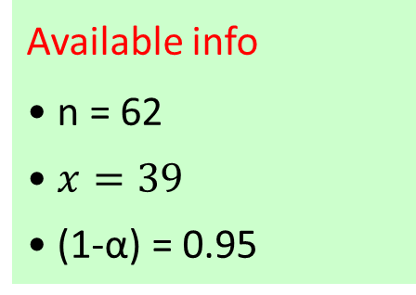


The random phenomenon is X: Introvert/Extrovert (Bernoulli(p))
We would like to estimate p: proportion of extrovert actors
Available info
• n = 62
• $x=39$
• (1-α) = 0.95
a) The point estimate for p is the proportion of extrovert actors in the sample, that is
$$\hat{p}=\frac{39}{62}=0.629$$
$$ME=z_{1−α/2}\sqrt{\frac{\hat{p}\left(1−\hat{p}\right)}{n}}$$
$$=1.96 \sqrt{\frac{0.629\left(1−0.629\right)}{62}}=0.12$$
$$1−α=0.95$$
$$⇒ α=0.05$$
$$⇒ α/2=0.025$$
$$\left(\hat{p}−ME,\hat{p}+ME\right):$$
$$\left(0.629−0.12, 0.629 +0.12\right):$$
$$⇒1− α/2=0.975$$
$${\left(0.509, 0.749\right)}_{95\%}$$
$$⇒z_{(1−\frac{α}{2})}=z_{0.975}$$
With 95% confidence, the proportion of extrovert actors in the population is between 51% and 75%
$$=invnorm\left(0.975\right)=1.96$$
With 95% confidence, the proportion of extrovert actors in the population is 63% with 12% margin of error

Slide 5
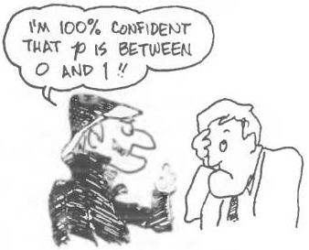
Heads UP
If the Confidence Interval (CI) contains negative values, which is a contradiction to probability theory (and the definition of proportion), you should increase the sample size since there is not enough information!
Similarly, if the CI contains values greater than one, a contradiction to probability theory (and the definition of proportion), there is not enough information!

Slide 6
Example
Use 95% confidence level IF it was not specified
Do NOT round your answer before final answer
A random sample of 71 students from a large class of Biostatistics is selected that consists of Pharmacy, Chemistry, and Occupational Therapy majors.
Our interest is obtaining a 95% CI for the percentage of students who are Pharmacy majors in this class. In our random sample we identified 20 Pharmacy, 31 Chemistry, and 20 Occupational Therapy majors.
Using Calculator:
Press STAT and go to TESTS Scroll down to A:1PropZInt Press ENTER
Select STATS Input Xbar, Sx, n, C-Level=(0.95)
Press Calculate

Slide 7

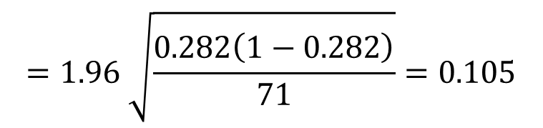
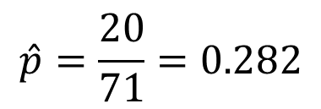
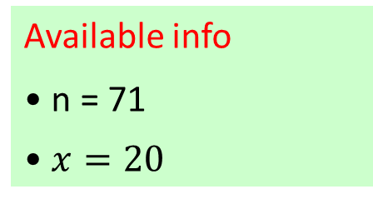

The random phenomenon is X: Pharm/Not-Pharm (Bernoulli(p))
We would like to estimate p: proportion of Pharm Students in class
Available info
• n = 71
• $x=20$
a) The point estimate for p is the proportion of Pharm students in the sample, that is
$$\hat{p}=\frac{20}{71}=0.282$$
$$ME=z_{1−α/2}\sqrt{\frac{\hat{p}\left(1−\hat{p}\right)}{n}}$$
$$=1.96 \sqrt{\frac{0.282\left(1−0.282\right)}{71}}=0.105$$
$$1−α=0.95$$
$$⇒ α=0.05$$
$$⇒ α/2=0.025$$
$$\left(\hat{p}−ME,\hat{p}+ME\right):$$
$$\left(0.282−0.105, 0.282 +0.105\right):$$
$$⇒1− α/2=0.975$$
$${\left(0.177, 0.387\right)}_{95\%}$$
$$⇒z_{(1−\frac{α}{2})}=z_{0.975}$$
With 95% confidence, the proportion of Pharm students in the class is between 17.7% and 38.7%
$$=invnorm\left(0.975\right)=1.96$$

Slide 8
Question
In a random sample of 300 people at a Philadelphia area, 107 voted for a new Tax reform. Let p be the true proportion of people in Philadelphia who vote for a new Tax reform. Construct a confidence interval with a 95% degree of confidence and interpret its results.
(0.30 , 0.41)

Slide 9

Sample Size Determination
VERY Important
Notes:
Before getting into statistical inference we have to determine how many sample should we take from the population, and it is a very important question because if we don’t take enough sample we might not be able to achieve the pre-set accuracy, and if the sample is way more than enough it always comes with more expenses and time and other issues
This section is about finding the right sample size for a study, and the formulas for these sample sizes are given in your formula sheet

Slide 10
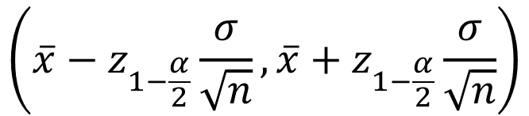
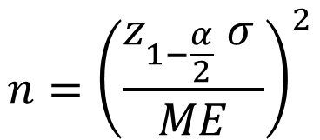
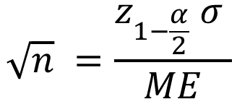


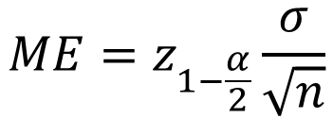
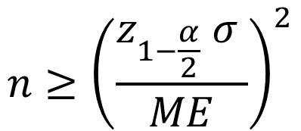
Estimating μ
(1-α)% CI for μ
$$\left(\overline{x}−z_{1−\frac{α}{2}}\frac{σ}{\sqrt{n}},\overline{x}+z_{1−\frac{α}{2}}\frac{σ}{\sqrt{n}}\right)$$
Known
I
II
In population type I and II, if we know the population standard deviation, level of confidence, and desired margin of error, then we can solve ME for n to find the necessary sample size.
n≥30
$$ME$$
$$ME=z_{1−\frac{α}{2}}\frac{σ}{\sqrt{n}}$$
$\sqrt{n} ME=z_{1−\frac{α}{2}}$ $σ$
$$\sqrt{n} =\frac{z_{1−\frac{α}{2}} σ }{ME}$$
$$n={\left(\frac{z_{1−\frac{α}{2}} σ }{ME}\right)}^{2}$$
$$n≥{\left(\frac{z_{1−\frac{α}{2}} σ }{ME}\right)}^{2}$$
ALWAYS round the answer UP
Notes:
In building a CI for population mean, in case I and II we used that formula, now we take a step back, if we had info about … we could use ME to find the necessary sample size.

Slide 11
Examples
Ex1. Determine the sample size, n, to obtain a 95% CI of the true mean of the breast cancer tumor size, to be taken from a large US database such that the size assures the estimate is within 0.1 cm of the true mean. Assume σ² = 0.81
Ex2. A politician claims that the standard deviation of the yearly income of teachers’ pay in FL is $1,000. How large a sample of teachers in the state must be taken if he wishes to estimate the true salaries of all the teachers in FL within $100 with 90% confidence?
Ex3. Find the minimum sample size necessary to have a 99% level of confidence that the true mean μ would be in that interval with a Margin of Error 0.2 with a population standard deviation of 1.30

Slide 12
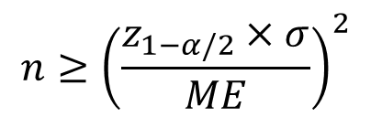
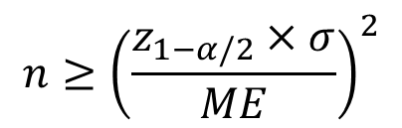
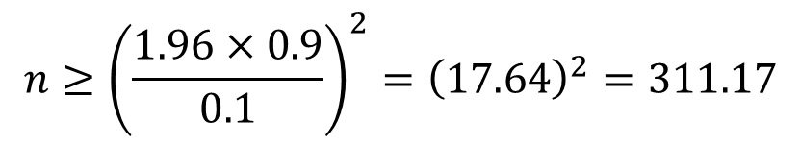
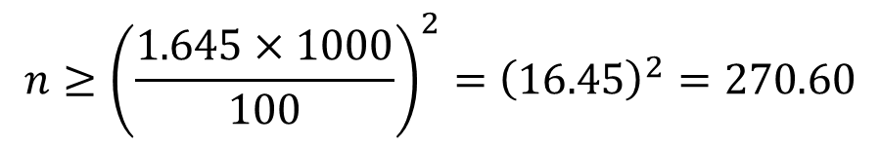


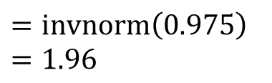
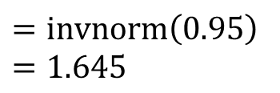


We have a sample size determination problem for estimating μ: mean of the breast cancer tumor size. Therefore:
• n = ?
• 1-α = 0.95
• ME = 0.1
• σ² = 0.81
$$z_{(1−\frac{α}{2})}=z_{0.975}$$
$$n≥{\left(\frac{z_{1−α/2}×σ}{ME}\right)}^{2}$$
$$=invnorm\left(0.975\right)$$
$$=1.96$$
$$n≥{\left(\frac{1.96×0.9}{0.1}\right)}^{2}={\left(17.64\right)}^{2}=311.17$$
$$n=312$$
We have a sample size determination problem for estimating μ: mean of teachers’ salaries in FL . Therefore:
• n = ?
• 1-α = 0.90
• ME = 100
• σ = 1000
$$z_{(1−\frac{α}{2})}=z_{0.95}$$
$$n≥{\left(\frac{z_{1−α/2}×σ}{ME}\right)}^{2}$$
$$=invnorm\left(0.95\right)$$
$$=1.645$$
$$n≥{\left(\frac{1.645×1000}{100}\right)}^{2}={\left(16.45\right)}^{2}=270.60$$
$$n=271$$
Notes:
Answers
Ex3: 282
Try the first example without the preliminary estimate and see the difference

Slide 13
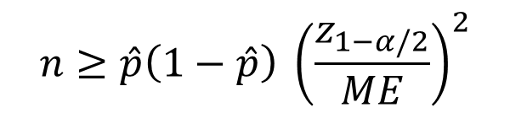
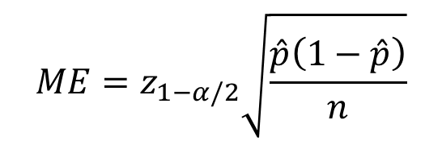
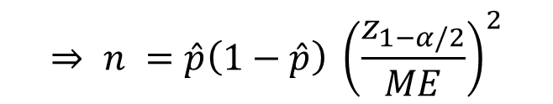
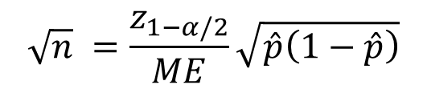

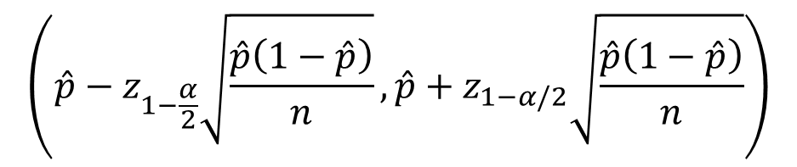
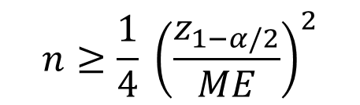
Estimating p
(1-α)% CI for p
$$\left(\hat{p}−z_{1−\frac{α}{2}}\sqrt{\frac{\hat{p}\left(1−\hat{p}\right)}{n}},\hat{p}+z_{1−α/2}\sqrt{\frac{\hat{p}\left(1−\hat{p}\right)}{n}}\right)$$
In estimating p if we specify the level of confidence and desired margin of error, then we can solve ME for n to find the necessary sample size.
$$ME=z_{1−α/2}\sqrt{\frac{\hat{p}\left(1−\hat{p}\right)}{n}}$$
$$\sqrt{n} ME=z_{1−α/2}\sqrt{\hat{p}\left(1−\hat{p}\right)}$$
$$\sqrt{n} =\frac{z_{1−α/2}}{ME}\sqrt{\hat{p}\left(1−\hat{p}\right)}$$
$$⇒ n =\hat{p}\left(1−\hat{p}\right) {\left(\frac{z_{1−α/2}}{ME}\right)}^{2}$$
IF a preliminary estimation for p is provided, use the first formula. If NOT, use the second.
$$n≥\hat{p}\left(1−\hat{p}\right) {\left(\frac{z_{1−α/2}}{ME}\right)}^{2}$$
$$n≥\frac{1}{4} {\left(\frac{z_{1−α/2}}{ME}\right)}^{2}$$
ALWAYS round the answer UP
Notes:
In building a CI for population proportion, we used that formula, now we take a step back, if we had info about … we could use ME to find the necessary sample size

Slide 14
Examples
Ex1. A pharmaceutical company that produces a certain drug advertises that it is 80% effective in reducing blood pressure. A clinician conducts an experiment to estimate the true proportion of effectiveness at 1% significance level. How many mice should suffer so the estimate will be within 0.01 of the true p?
Ex2. A random sample of medical files is used to estimate the proportion of all people who have blood type B. If you have no preliminary estimate for true proportion, how many medical files should you include in a random sample in order to be 85% sure that the point estimate is within a distance of 0.05 from true?
Ex3. Find the sample size necessary to determine the proportion within 7% at the 10% level of significance when no preliminary estimated proportion is given.

Slide 15
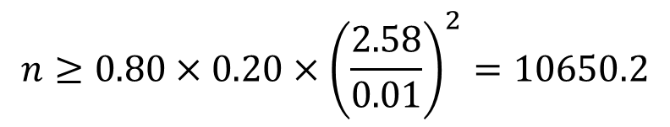

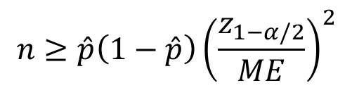

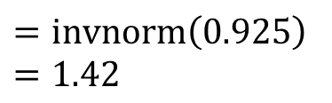
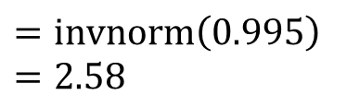


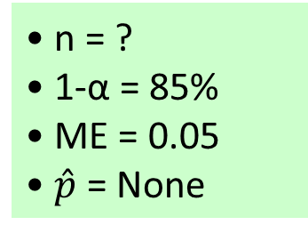
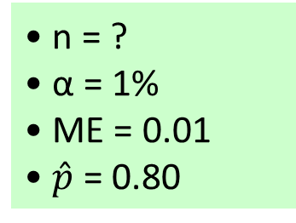

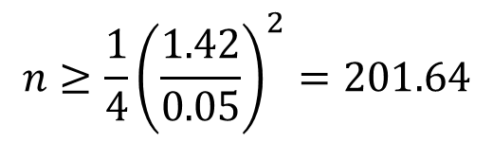
We have a sample size determination problem for estimating p: proportion of effectiveness for the drug. Therefore:
• n = ?
• α = 1%
• ME = 0.01
• $\hat{p}$ = 0.80
$$z_{(1−\frac{α}{2})}=z_{0.995}$$
$$n≥\hat{p}\left(1−\hat{p}\right){\left(\frac{z_{1−α/2}}{ME}\right)}^{2}$$
$$=invnorm\left(0.995\right)$$
$$=2.58$$
$$n≥{0.80×0.20×\left(\frac{2.58}{0.01}\right)}^{2}=10650.2$$
$$n=10651$$
We have a sample size determination problem for estimating p: proportion of people who have blood type B. Therefore:
• n = ?
• 1-α = 85%
• ME = 0.05
• $\hat{p}$ = None
$$z_{(1−\frac{α}{2})}=z_{0.925}$$
$$n≥\frac{1}{4} {\left(\frac{z_{1−α/2}}{ME}\right)}^{2}$$
$$=invnorm\left(0.925\right)$$
$$=1.42$$
$$n≥\frac{1}{4}{\left(\frac{1.42}{0.05}\right)}^{2}=201.64$$
$$n=202$$
Notes:
In Ex1, in case we didn’t have a primary estimate for the true proportion, we would require 10651 samples, using the second formula.
Ex3: 139

Slide 16
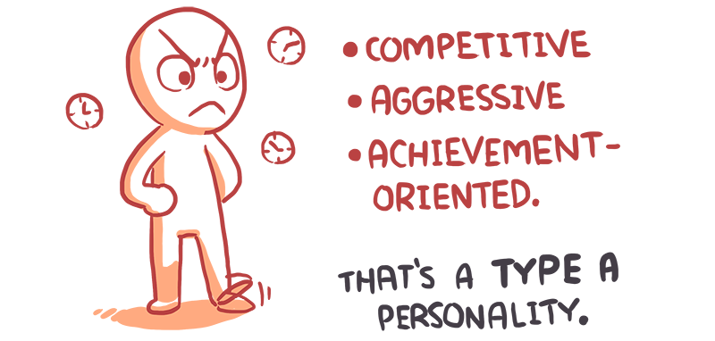


Practice Problems Part 3
1. In a random sample of 1000, only 426 were type “A” personality. Build a 95% CI to test the statement that in the U.S. population, 38.8% of people are type “A” personality.
2. In a random sample of 300 people at a Philadelphia area, 107 voted for a new Tax reform. Construct a 95% confidence interval for the true proportion of people in Philadelphia who vote for a new Tax reform and interpret its results.
Notes:
Answers are provided in Ch6 Practice Problem Solutions

Slide 17
Practice Problems Part 3
3. Determine the sample size, n, to obtain a 90% CI of the true mean of the breast cancer tumor size, to be taken from a large US database such that the size assures the estimate is within 0.1 cm of the true mean. Assume σ²=0.81.
4. If a retailer would like to estimate the proportion of their customers who bought an item after viewing their website on a certain day with a 95% confidence and 5% margin of error, how many customers do they have to monitor?
5. To estimate the next president's final approval rating, how many people should be sampled so that the margin of error is 3%, (a popular choice), with 95% confidence? Use educated guess: Bush's = 0.22
Notes:
Answers are provided in Ch6 Practice Problem Solutions

